Slide 1







Presentation on Analysis of Technology Skills and Emerging Trends
Vincent S. Pereira
22nd November 2023

Slide 2




OUTLINE
Executive Summary
Introduction
Methodology
Results
Visualization – Charts
Dashboard
Discussion
Findings & Implications
Conclusion
Appendix

Slide 3

EXECUTIVE SUMMARY
JavaScript & HTML/CSS are currently the most popular programming languages and continue to be so even next year.
Though Python is at the 5th position this year, it is steadily becoming more popular and is destined to become the 3rd most popular language, surpassing SQL.
PostgreSQL & MongoDB are rising steadily in popularity amongst databases and by next year would snatch the 1st and the 2nd place from MySQL & Microsoft SQL Server.
While Windows & Linux are the most used platforms currently, Linux will continue to be the most desired platform next year, along with Docker.
React.js will overtake jQuery as the most desired Web Frames next year.

Slide 4

INTRODUCTION
The goal of this exercise is to analyse the current and the future trends in the software development market.
The analysis will assist developers to understand which programming languages, databases, web frameworks and platforms are being used currently and whether they would still remain popular in the future.
It will help developers to identify which skills they should upgrade, so as to be future ready.
This report will understand the demographics, like, age, gender, education level, salaries, location, etc. of the professionals working in the technology sector.
The data has been collected from various sources like, Stack Overflow Survey, GitHub job postings, etc.

Slide 5

METHODOLOGY
Data Collection:
Data is collected through various sources like, Stack Overflow Surveys, etc. using APIs, Web Scrapping and data provided by IBM.
Data Wrangling:
Finding Duplicates and Removing them, finding Missing values and Imputing them, Normalising Data, etc.
Exploratory Data Analysis:
Examining Distribution of Data, identifying & removing Outliers, understanding the correlation between different features in the dataset, etc.
Data Visualisation:
Creating various charts and graphs by using python libraries like, Matpoltlib, Seaborn, etc.
Building Dashboards:
Using Data Analytics platforms like, IBM Cognos, Tableau, Power BI, etc.
Presenting the Findings

Slide 6
RESULTS
The Mean Annual Salary of Responders identifying themselves as ‘Man’ was $133,690, while for those identifying themselves as ‘Woman’ was $101,103.
The sample size reduced from 11,398 to 10,519 after the removal of Outliers.
After removing the Outliers, the Mean Annual Salary of the Responders decreased from $131,597 to $59,883.
Post the Outlier removal, the Mean Annual Salary for Men was $59,732, which was much lower than that for Women, whose Mean Annual Salary was $60,868.
Before the removal of Outliers, 10,480 Responders identified themselves as ‘Man’, while only 731 Responders identified themselves as a ‘Woman’.
After the removal of Outliers, this figure for Men came down to 9,650, while that for Women came down to 694.
The Mean Age of the Responders was 30.
GitHub Link:
https://github.com/vincyspereira/Coursera-IBM-Data-Analyst-Capstone-Project/tree/b081ddfcddc13e74cafea5a361fd5a0e4b88b2f1

Slide 7
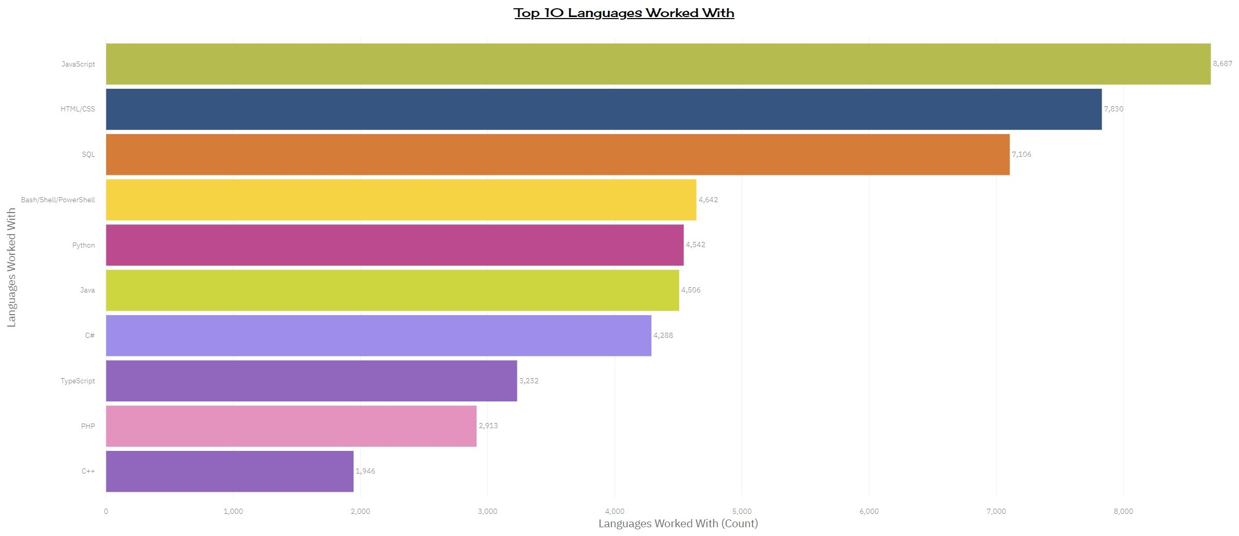
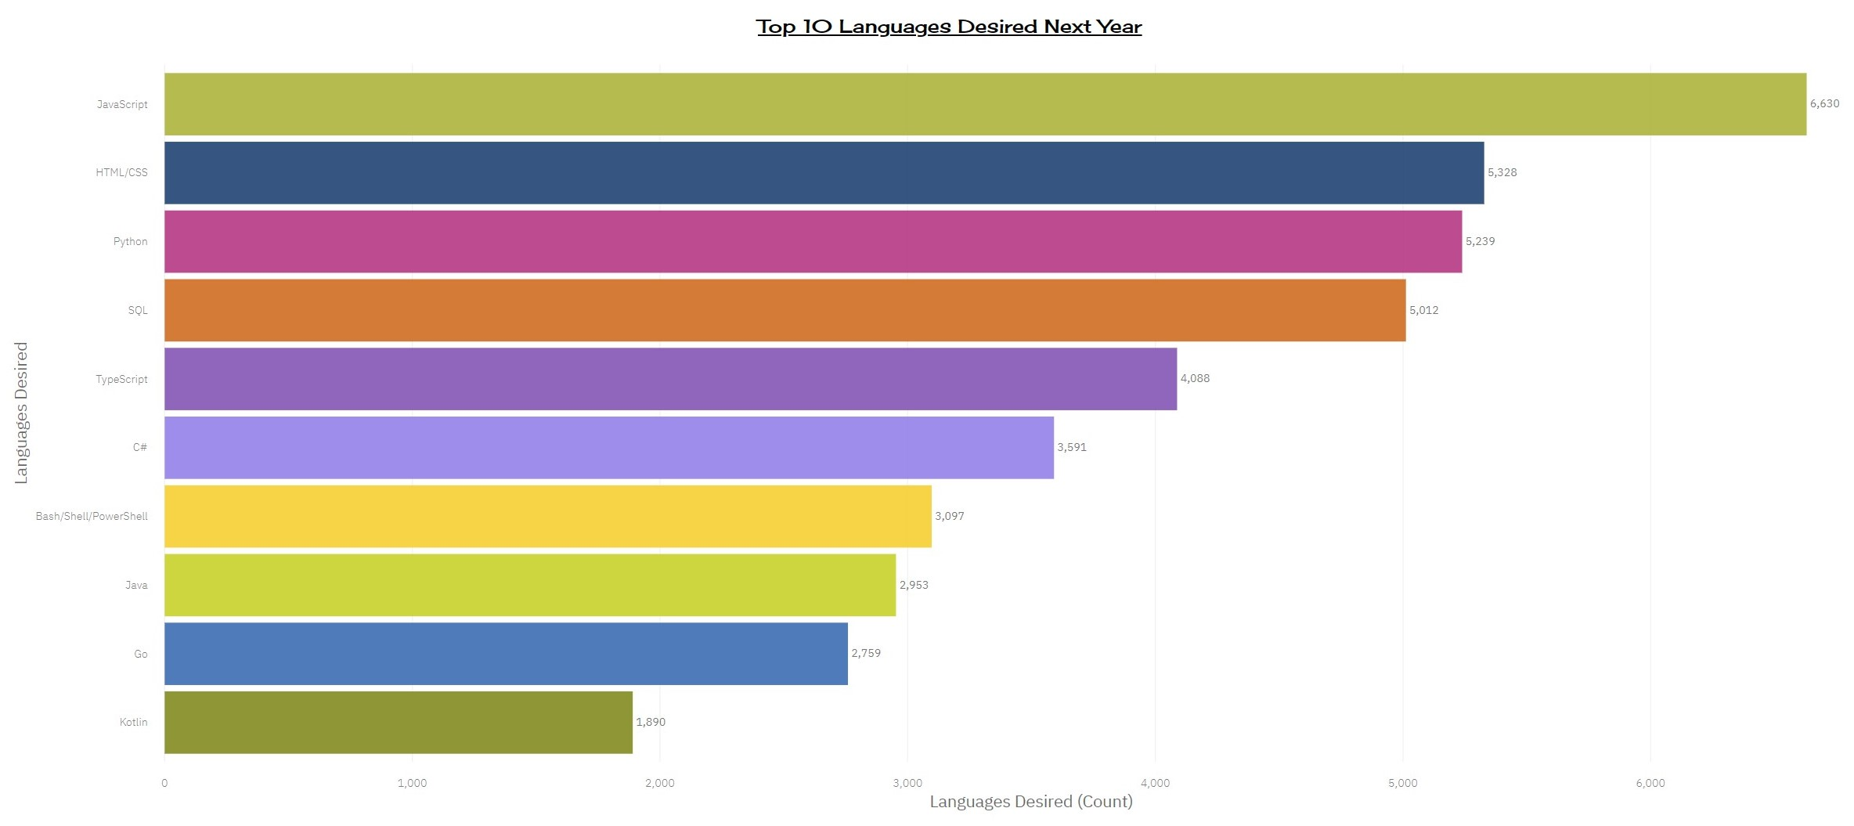
PROGRAMMING LANGUAGE TRENDS
Current Year:
Next Year:

Slide 8
PROGRAMMING LANGUAGE TRENDS: FINDINGS & IMPLICATIONS
Findings:
JavaScript and HTML/CSS will retain their popularity next year and rank 1st and 2nd respectively.
Python and TypeScript will rise in popularity next year, wherein Python will become more popular than SQL.
SQL will continue to be popular next year and will remain in the Top 5 Programming Languages.
Go and Kotlin have moved in the Top 10, while PHP and C++ are out of the Top 10 list.
Bash/Shell/PowerShell and Java have declined in popularity as compared to the current year.
Implications:
JavaScript, HTML/CSS and TypeScript, which are Web Development programming languages are in high demand.
Due to the low Learning Curve and the increase in demand for Machine Learning and Deep Learning skills, Python is rising in popularity.
Data Scientists, Data Engineers, Business Analysts and Big Data Companies are still using SQL.
Languages like C++ and PHP are becoming less popular dues to its high Learning Curve and limited usability.

Slide 9
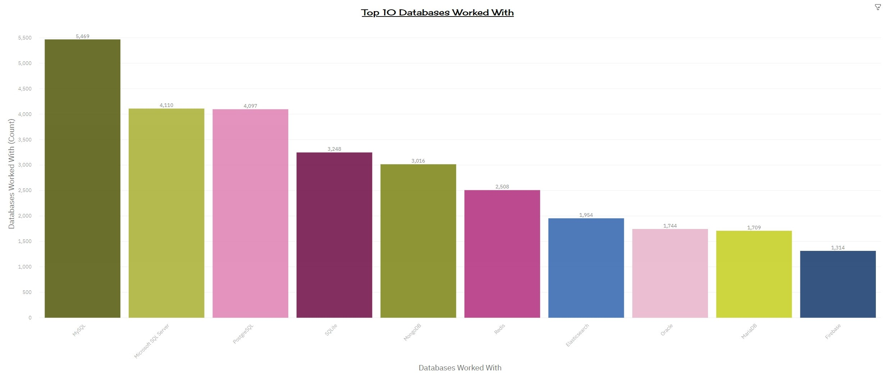
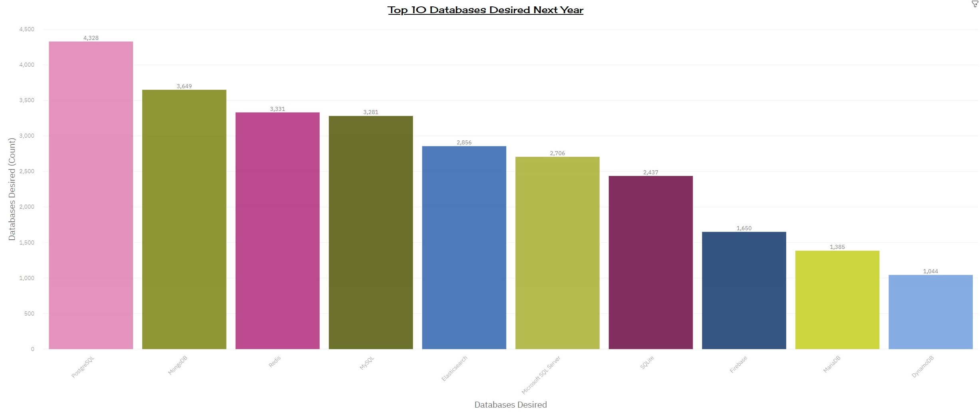
DATABASE TRENDS
Current Year:
Next Year:

Slide 10
DATABASE TRENDS: FINDINGS & IMPLICATIONS
Findings:
PostgreSQL & MongoDB are rising steadily in popularity amongst databases and by next year, they will replace MySQL & Microsoft SQL Server from their current positions.
The popularity of Oracle has declined so much that it will be out of the Top 10 Databases next year.
Oracle will be replaced by DynamoDB by the next year.
Redis and Elasticsearch are rising in popularity.
Implications:
Open-Source databases seem to be rising in popularity, especially due to their large support network.
With the increase in unstructured and non-relational data, the popularity of NoSQL databases is rising.
The future technology trend shows that a developer, data scientist, business analyst, etc. needs to have good knowledge of both SQL and NoSQL technologies.

Slide 11

DASHBOARD
Permanent link of the read-only view of Cognos Dashboard:
https://dataplatform.cloud.ibm.com/dashboards/37ea031b-c7b3-43df-88fb-7a3df263e237/view/4e35d57838b12fdf74edc0e407992f577e662154b1bb8b05d3807b495a697097f0611597c8284f5b88430663f1e9115fc1
Note:
If for some reason, some of the charts or the entire Dashboard is not visible, kindly refresh the page to view the Cognos Dashboard.
You should be able to view a total of 12 charts (4 charts per page x 3 pages).
It sometimes takes a few minutes to refresh the page.

Slide 12
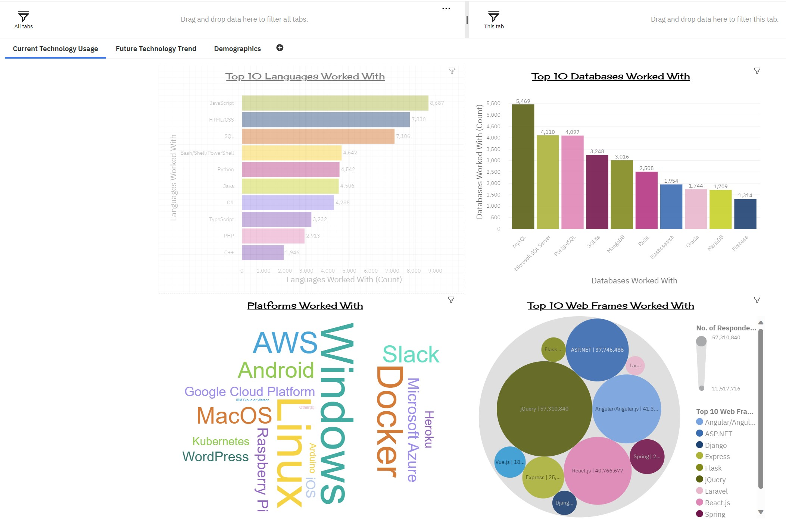
DASHBOARD TAB 1: CURRENT TECHNOLOGY USAGE

Slide 13
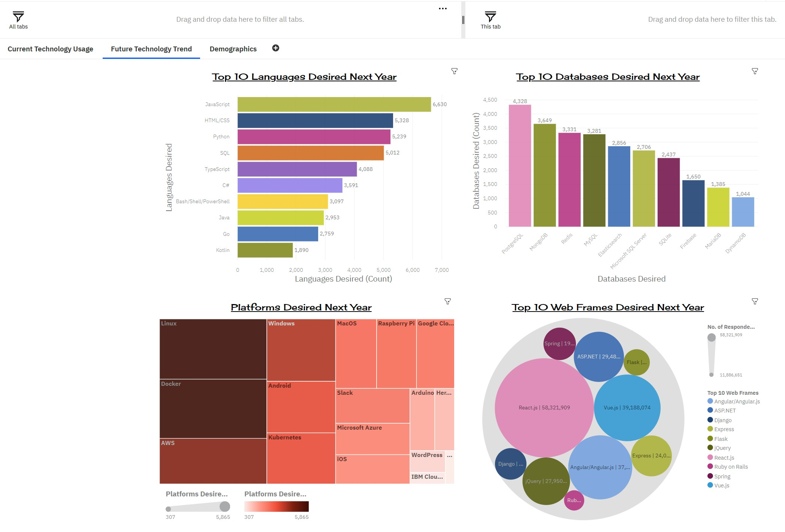
DASHBOARD TAB 2: FUTURE TECHNOLOGY TREND

Slide 14
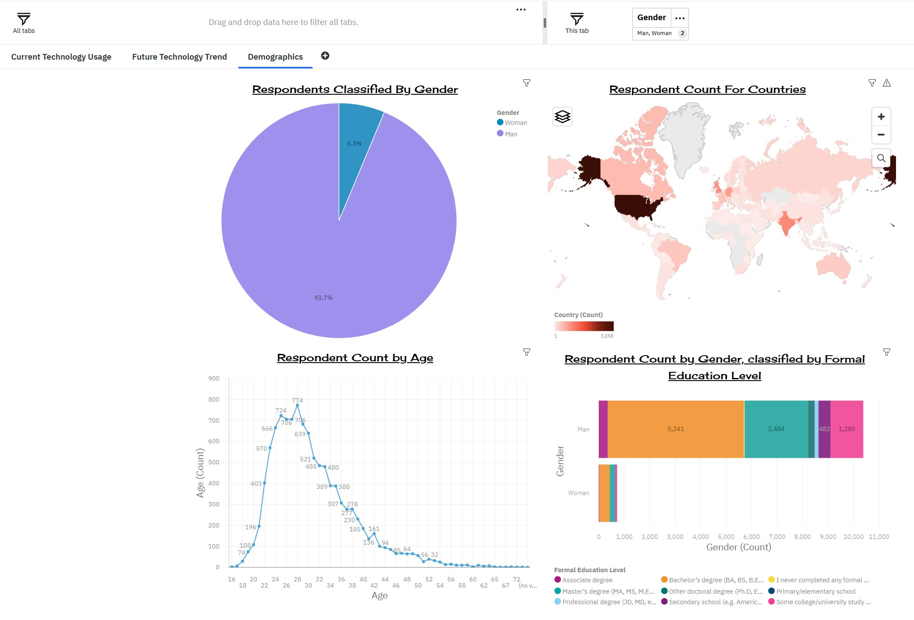
DASHBOARD TAB 3: DEMOGRAPHICS

Slide 15
DISCUSSION
How can countries, especially the economically weak ones, ensure their citizens are trained in technology and are job ready?
How can countries create an eco system to ensure that technology is incorporated into all the sectors of an economy?
Apart from the traditional routes like, bachelor’s & master’s degrees required to be educated in technology, are there any other routes for people to be trained in technology?
What can be done to reduce the gender pay gap?
Which technologies and platforms are in demand currently?
Which technologies and platforms will remain in demand in by the next year?
Which technology pays the most?
Which technology will become obsolete?

Slide 16
OVERALL FINDINGS & IMPLICATIONS
Findings:
Most of the programming jobs are concentrated in countries like USA, Europe and India.
There is a major gap in gender pay, with men earning more than the women.
More than 93% of the people in the field of technology are Men.
Maximum number of people working in technology are in the Age group of 24 to 30 years.
Maximum number of the technology job holders have a Bachelor’s degree, followed by those with a Master’s degree.
Most of the respondents want to learn JavaScript, HTML/CSS, Python, PostgreSQL, MongoDB, React.js, Linux and Docker in the next year.
Implications:
Programming Languages like Python, that are advanced and yet easy to learn are becoming more popular.
Developers are losing interest in programming languages like Java and C++, as they have a very high learning curve and the complex jobs managed by them can now easily be done using simpler languages.
With the rise in big, unstructured & non-relational data, the popularity of SQL and NoSQL is rising by the day.
Cloud based services are now the preferred choice for many companies as it drastically reduces the infrastructure and maintenance cost.
More countries need to provide trainings in technology and also create an appropriate eco system for the same.

Slide 17

CONCLUSION
The analysed data provided many insights into the current & the future trends in technology.
It also provided insights into technologies that were out of trend & those that were in demand.
The analysis will assist developers to understand which programming languages, databases, web frameworks and platforms are in demand, so that they can upgrade their skills, if required, and be future ready.
This report will help in understanding demographics, like, age, gender, education level, salaries, location, etc. of the professionals working in the technology sector.
This will further help individuals, organisations and policy makers to take appropriate measures to manage the areas of short fall, gap in gender pay, etc.
In order to remain competitive, developers, data analysts, data scientists, data engineers, business analysts, etc. need to keep upgrading themselves and be abreast with the latest technologies.

Slide 18
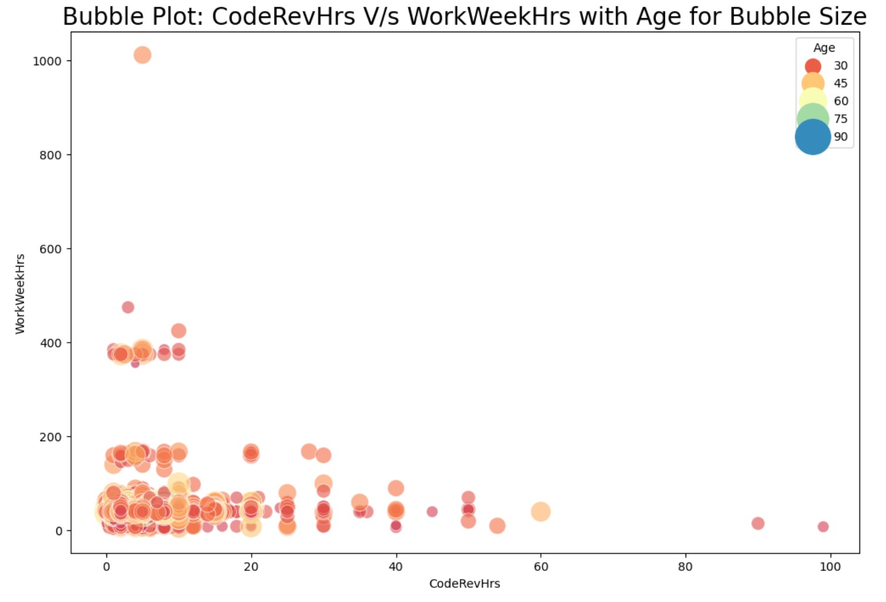
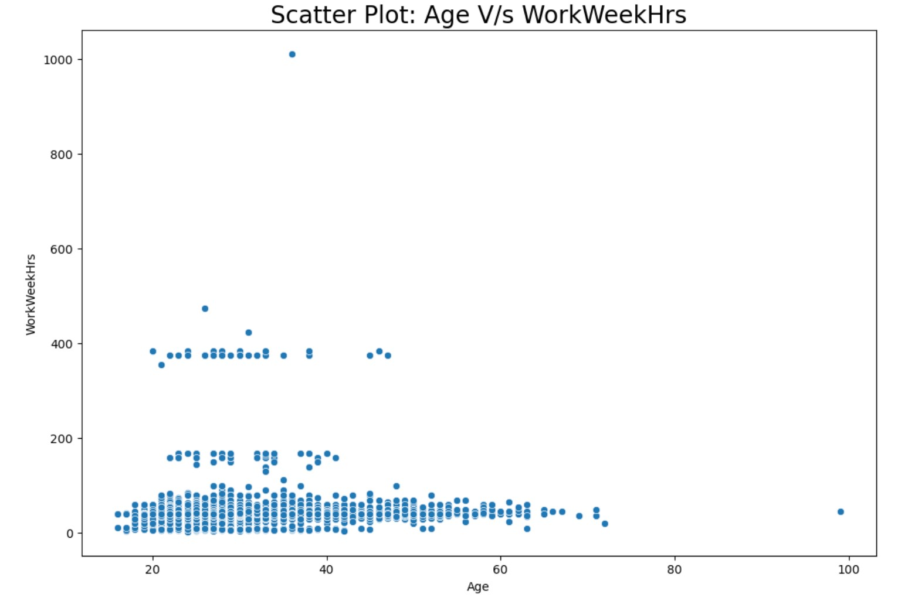
APPENDIX 1
Include any relevant additional charts, or tables that you may have created during the analysis phase.

Slide 19
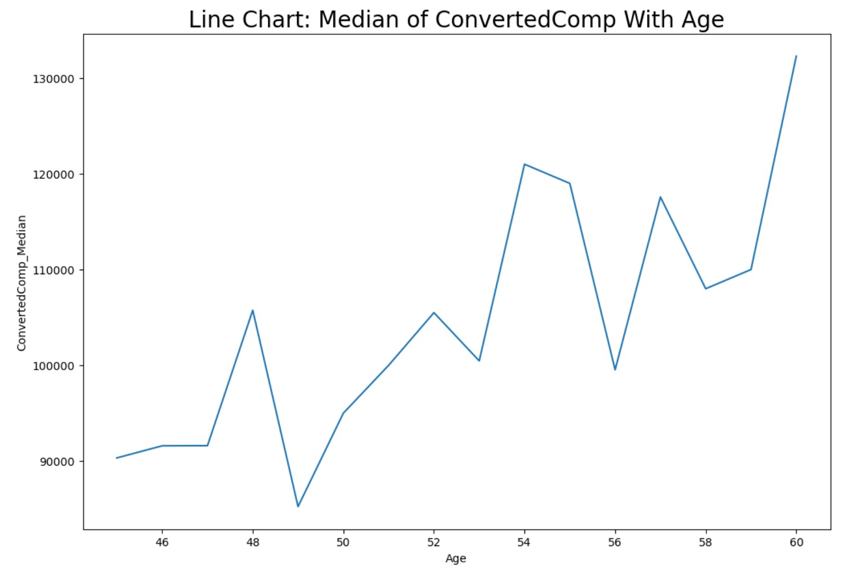
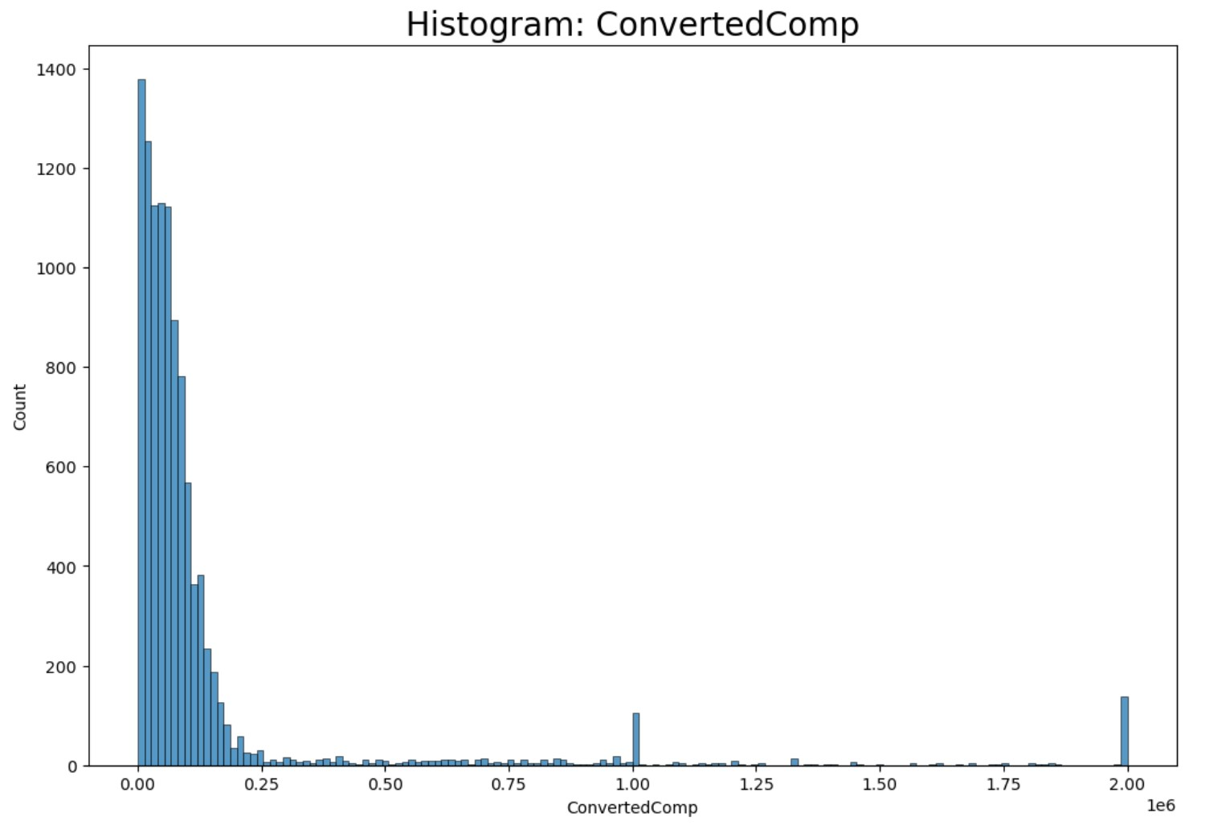
APPENDIX 2
Include any relevant additional charts, or tables that you may have created during the analysis phase.

Slide 20
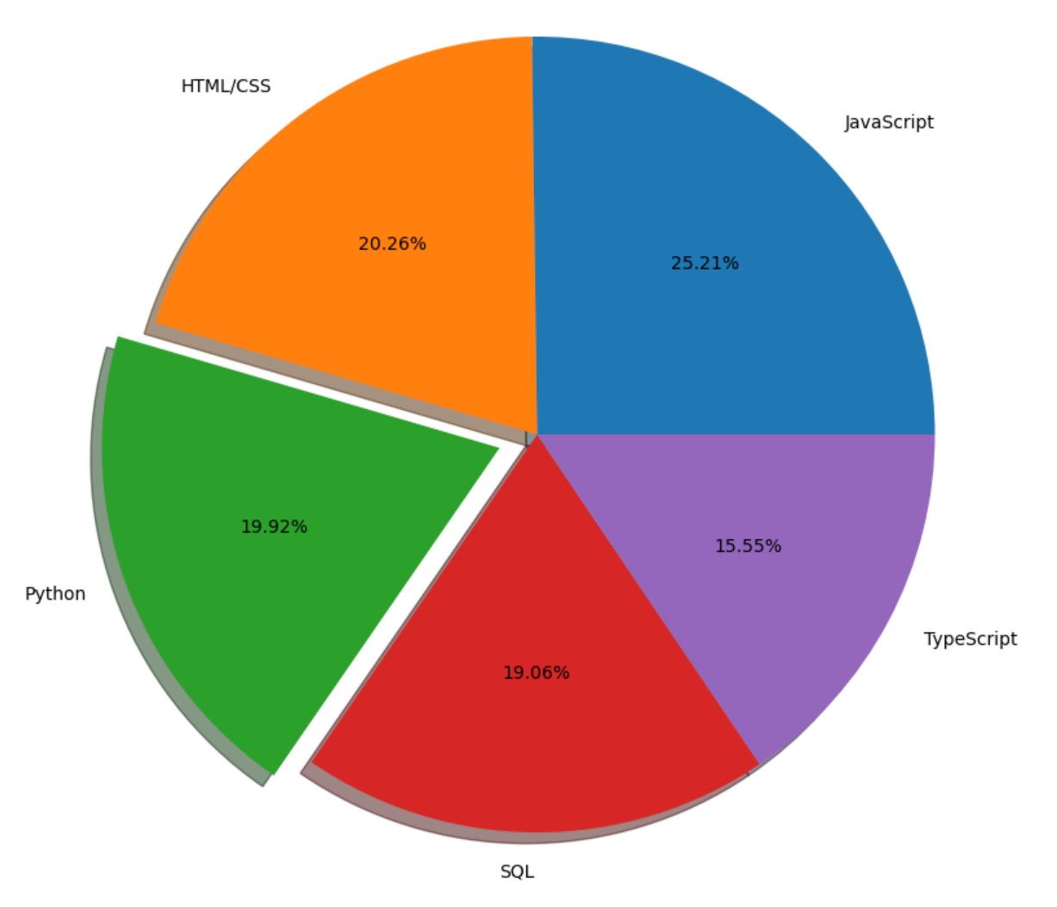
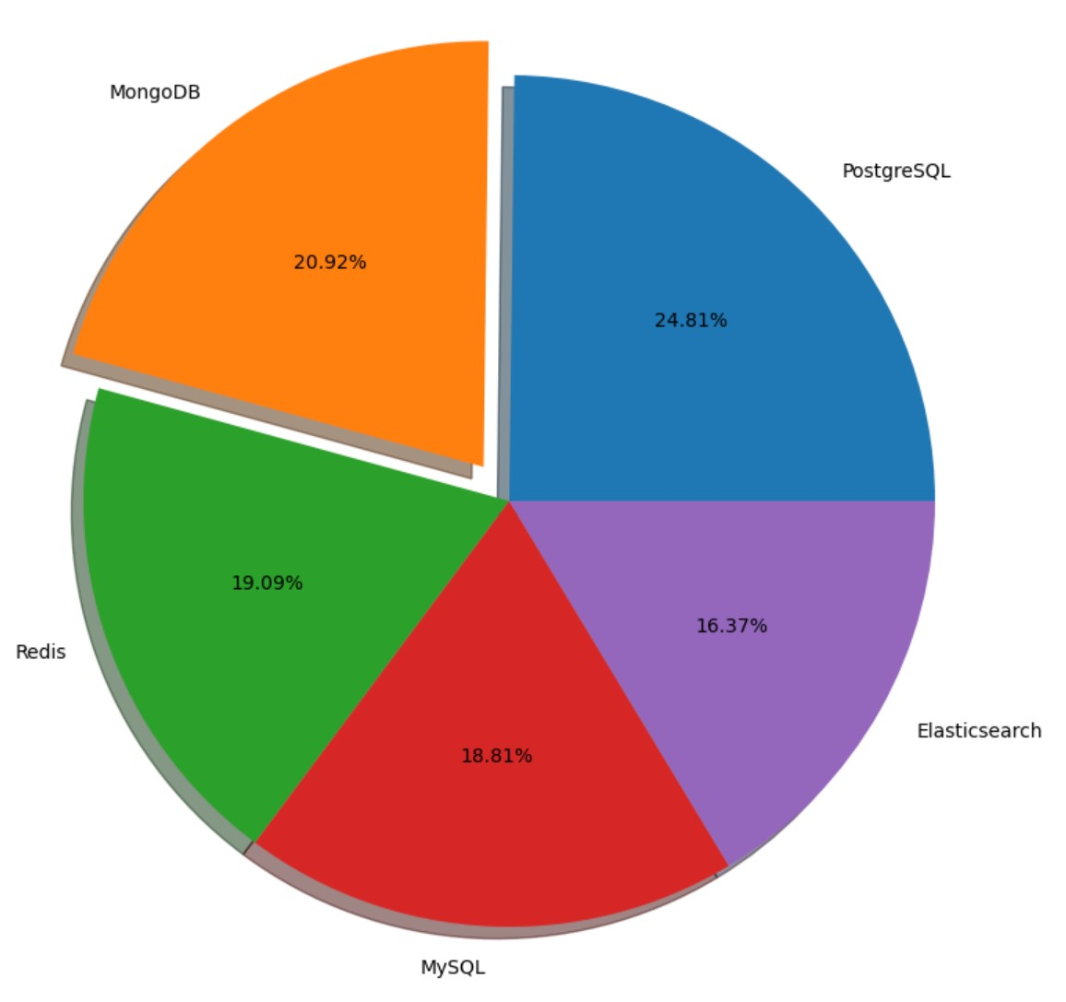
APPENDIX 3
Pie Charts of Top 5 Programming Languages Desired Next Year and Top 5 Databases Desired Next Year.

Slide 21
JOB POSTINGS
In Module 1 you have collected the job posting data using Job API in a file named “job-postings.xlsx”. Present that data using a bar chart here. Order the bar chart in the descending order of the number of job postings.

Slide 22
POPULAR LANGUAGES
In Module 1 you have collected the job postings data using web scraping in a file named “popular-languages.csv”. Present that data using a bar chart here. Order the bar chart in the descending order of salary.

Slide 23
Thank You

